Slide 1
Artificial Intelligence in the Financial Industry
2025
Kylie Fan

Slide 2
CONTENTS
01
02
03
AI Applications in the Financial Industry
Financial Data Processing & Analysis
Financial Data Processing & Analysis
04
05
AI Modeling Basics for Finance
AI Modeling Basics for Finance

Slide 3
AI Modeling Basics for Finance
05
Building & Evaluating Financial AI Models

Slide 4



Learn how to train, validate, and evaluate financial ML models

Slide 5
Training Process Overview
Data prep: Train/Test split
70/30 or 80/20 split
Model training
Validation and tuning

Slide 6
Evaluation Metrics
Regression: MSE, RMSE, MAE
Classification: Accuracy, Precision, Recall, F1

Slide 7
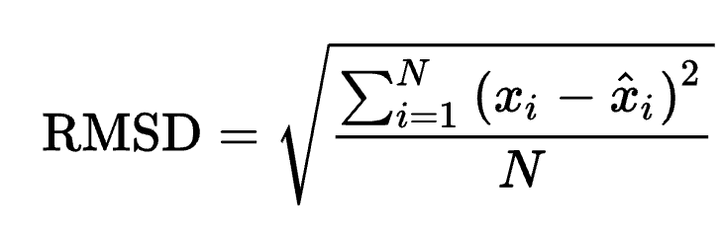
Regression Metrics
Mean Squared Error (MSE)
Formula: MSE = 1/n Σ(yᵢ - ŷᵢ)²
Sensitive to outliers
Root MSE (RMSE)
Formula:
Interpretable units
Mean Absolute Error (MAE)
Formula: MAE = 1/n Σ|yᵢ - ŷᵢ|
Robust to outliers

Slide 8
Classification Metrics
Accuracy
Formula: (TP + TN) / Total
Misleading for imbalanced data
Precision
Formula: TP / (TP + FP)
"How many selected are relevant?"
Recall
Formula: TP / (TP + FN)
"How many relevant are selected?"
F1 Score
Formula: 2 × (Precision × Recall) / (Precision + Recall)
Balances precision/recall

Slide 9

Google AutoML for Finance

Slide 10
Credit Risk Classification Using AutoML Tables
Objective: Predict whether a borrower will default on a loan using demographic and financial variables
Step 1: Dataset
https://www.kaggle.com/competitions/GiveMeSomeCredit/data?select=cs-training.csv

Slide 11
Credit Risk Classification Using AutoML Tables
Target Variable: SeriousDlqin2yrs (1 = default, 0 = no default)
Feature Include:
RevolvingUtilizationOfUnsecuredLines
age
DebtRatio
MonthlyIncome
NumberOfOpenCreditLinesAndLoans
NumberRealEstateLoansOrLines

Slide 12
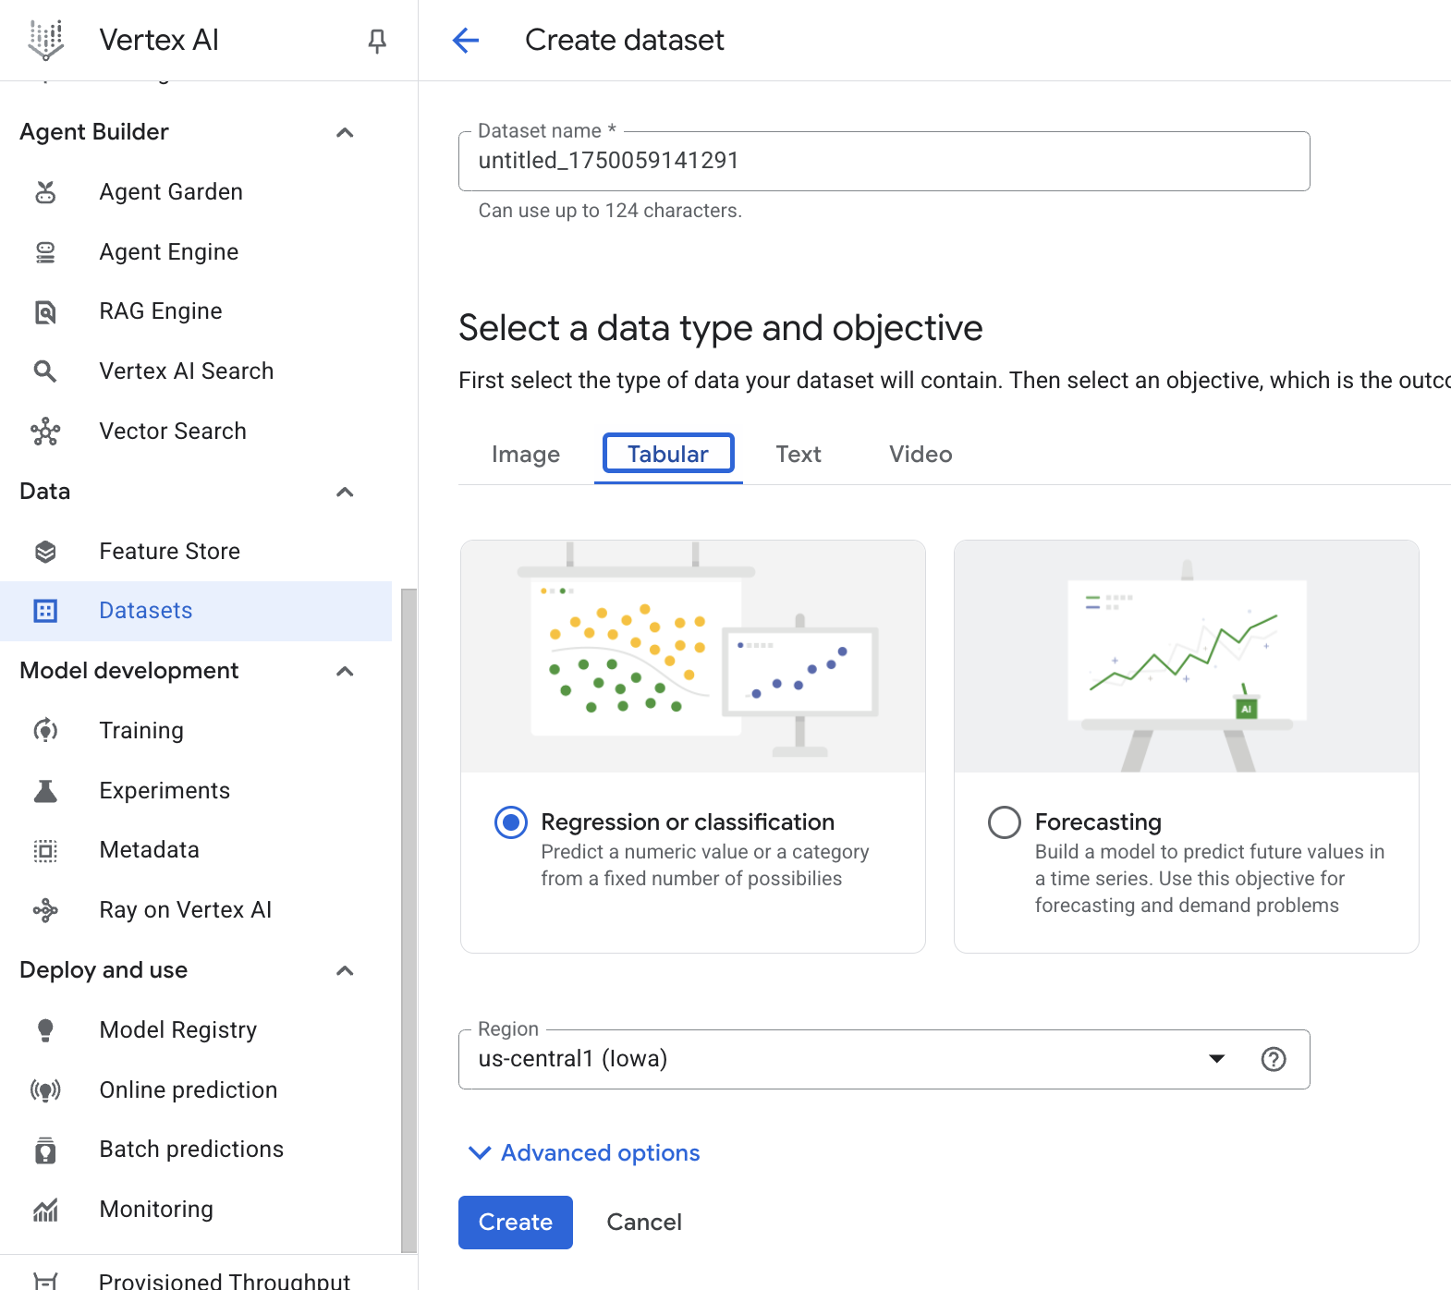
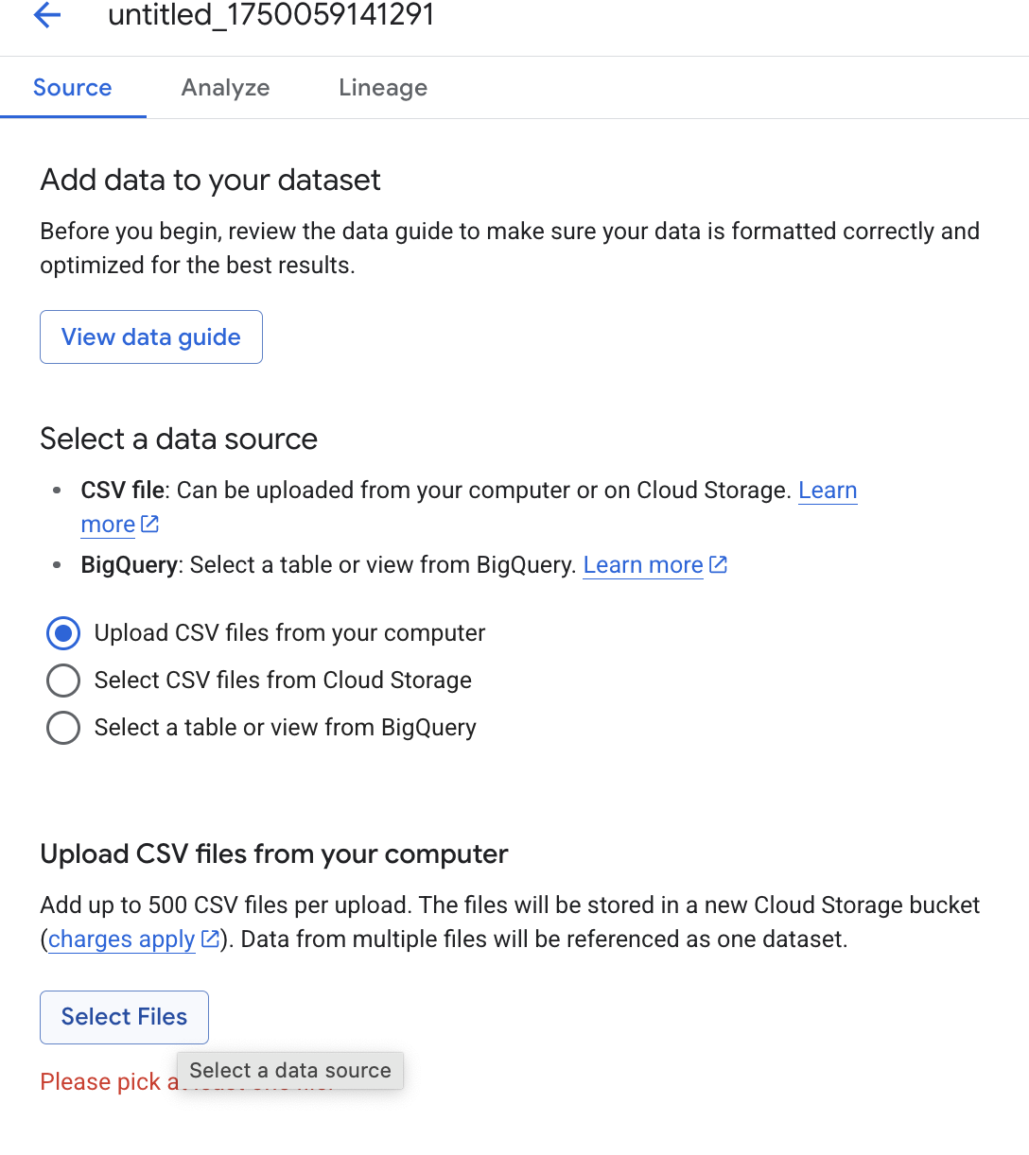
Credit Risk Classification Using AutoML Tables
Step 2: Upload to Google AutoML Tables
Go to Vertex AI > Data > Datasets > Create > Tabular
Click Create Dataset > Upload CSV

Slide 13
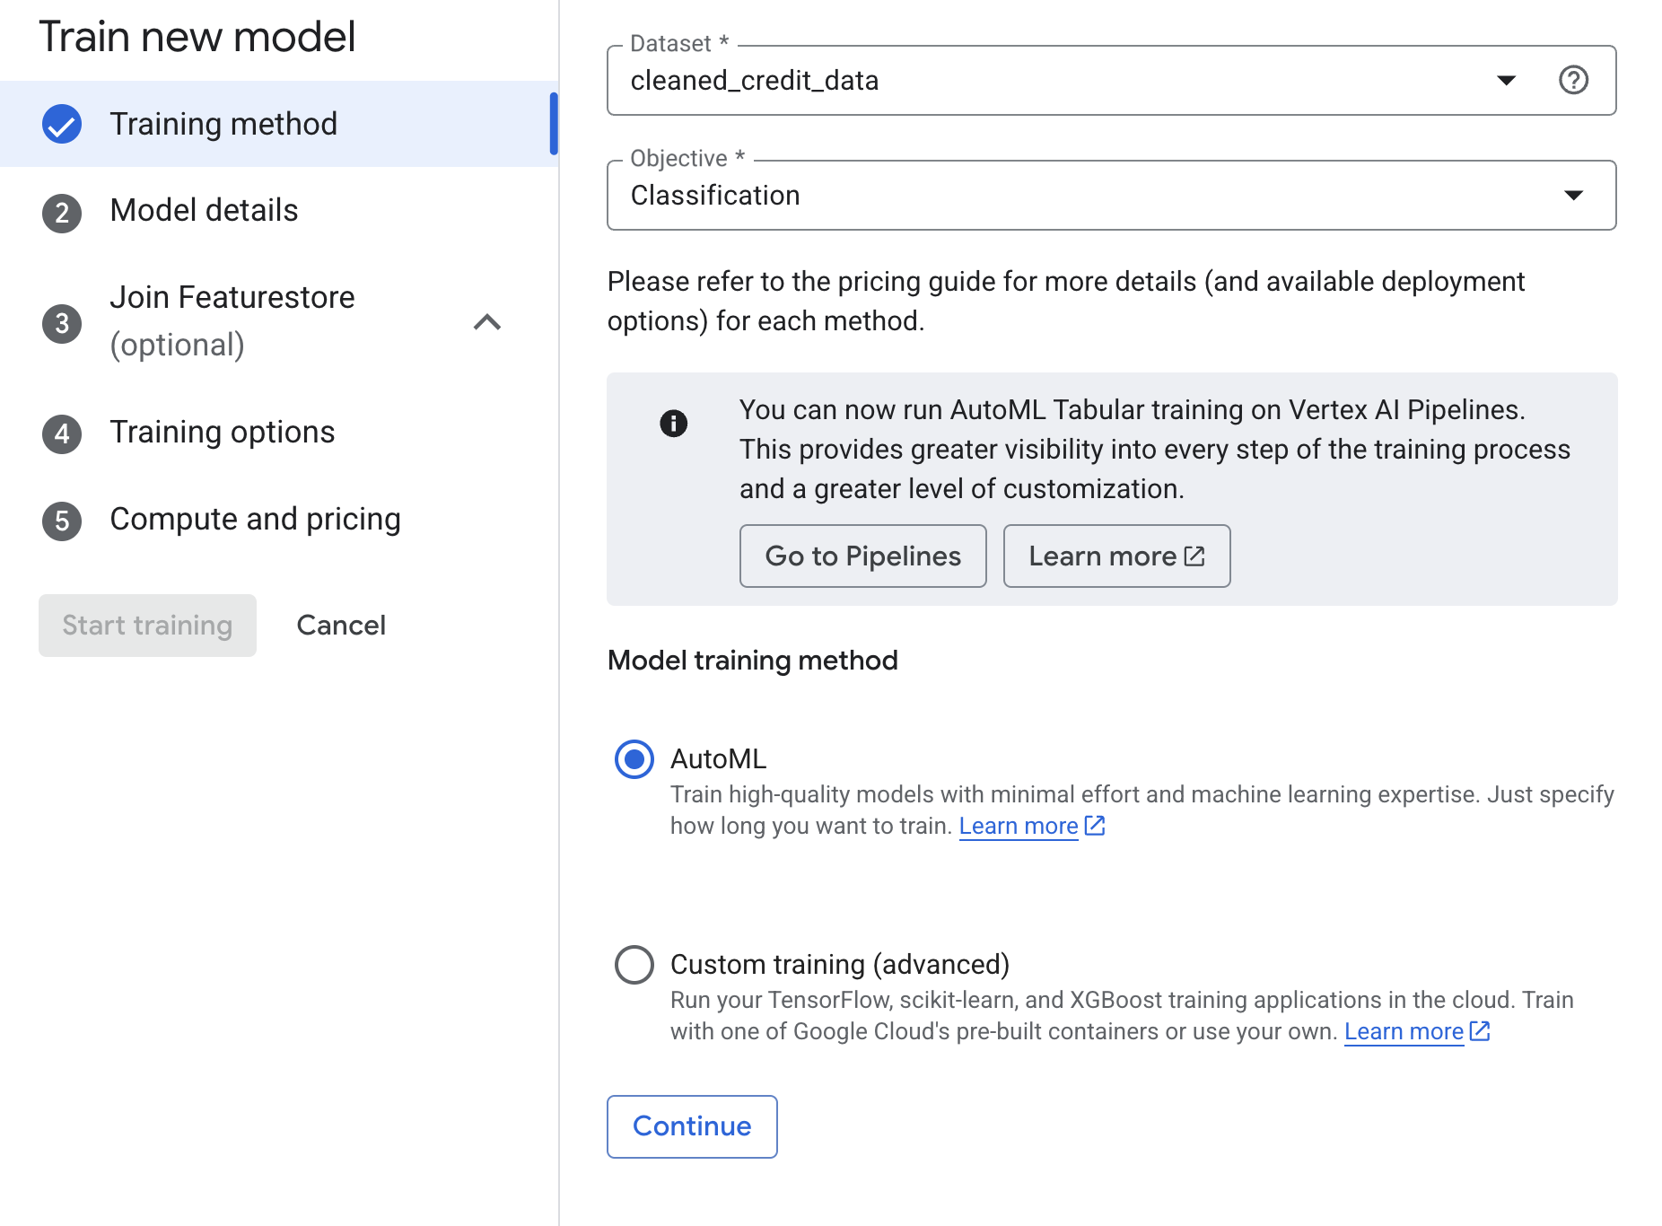
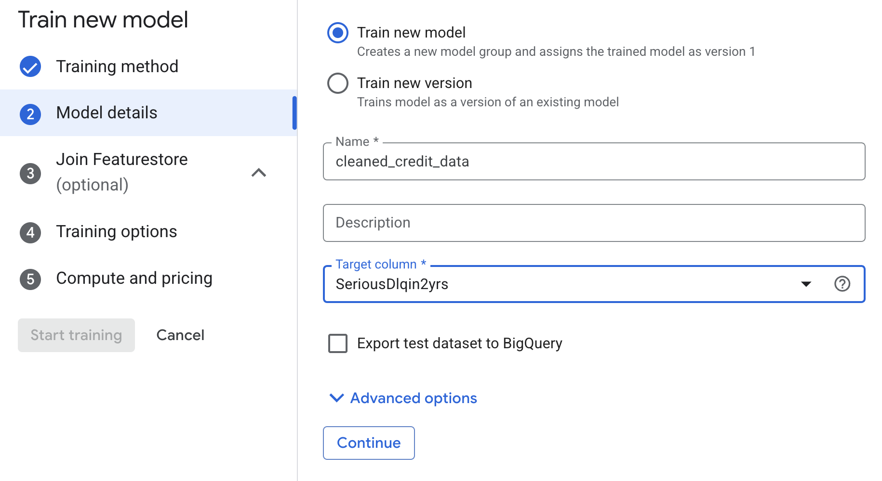
Credit Risk Classification Using AutoML Tables
Select your target column: SeriousDlqin2yrs
Let AutoML detect data types

Slide 14
Credit Risk Classification Using AutoML Tables
Step 3: Train the Model
Choose Binary Classification
Set training budget (e.g., 1 hour)
AutoML automatically:
Cleans data
Selects features
Tunes model (XGBoost, Neural Nets, etc.)

Slide 15
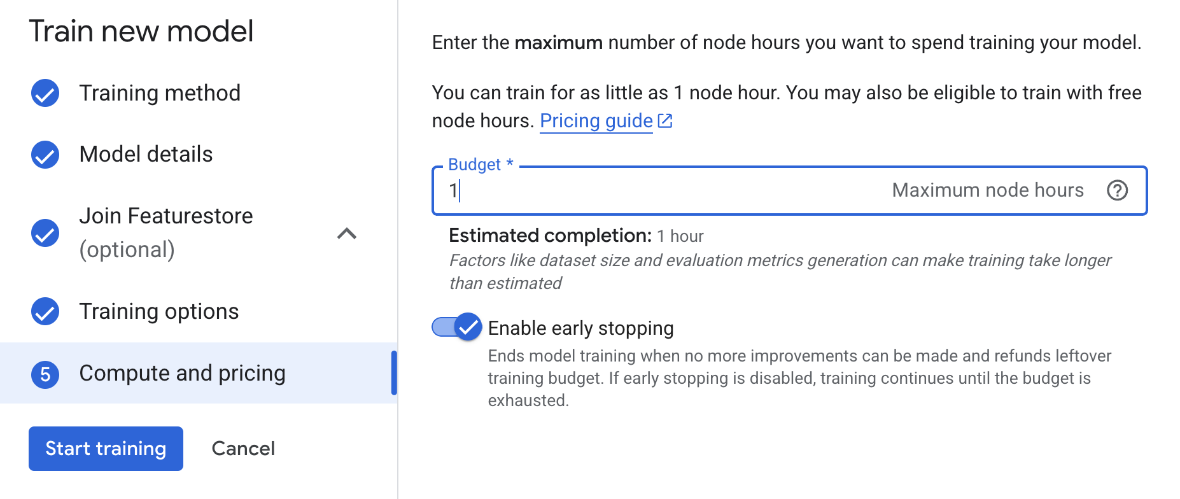
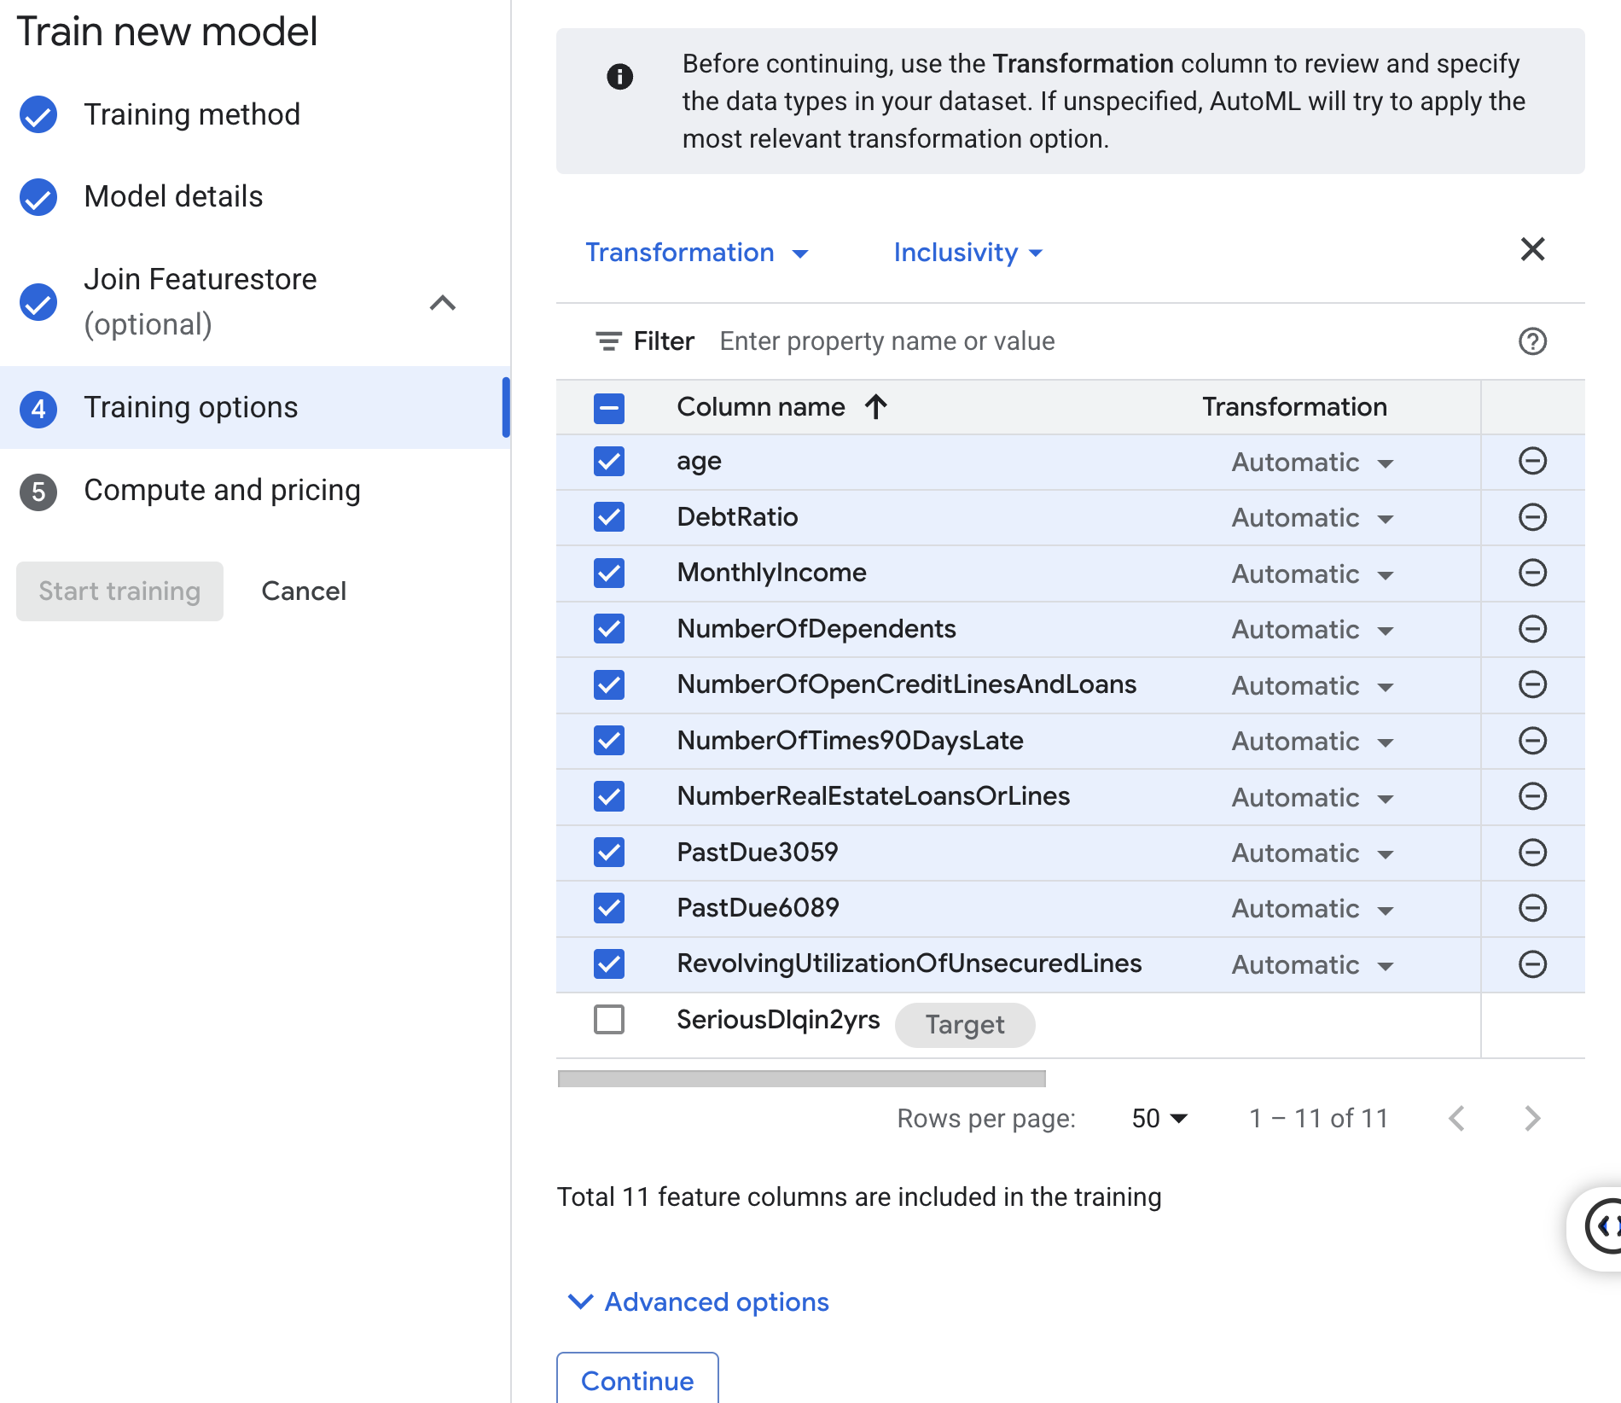
Credit Risk Classification Using AutoML Tables
Step 3: Train the Model

Slide 16
Credit Risk Classification Using AutoML Tables
Step 4: Review Results
Metrics shown:
ROC AUC
Precision, Recall
Confusion Matrix
Feature Importance Output:
Top drivers of default risk (e.g., RevolvingUtilizationOfUnsecuredLines)

Slide 17
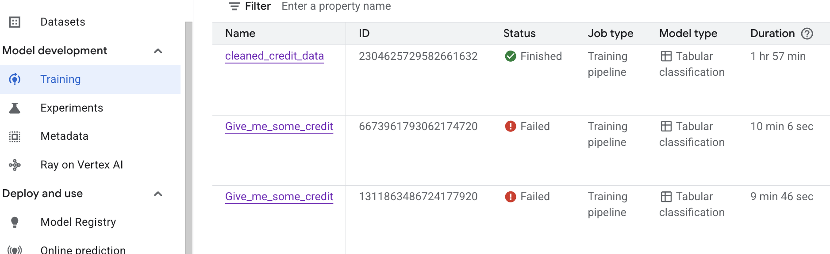
Credit Risk Classification Using AutoML Tables
Step 4: Review Results

Slide 18
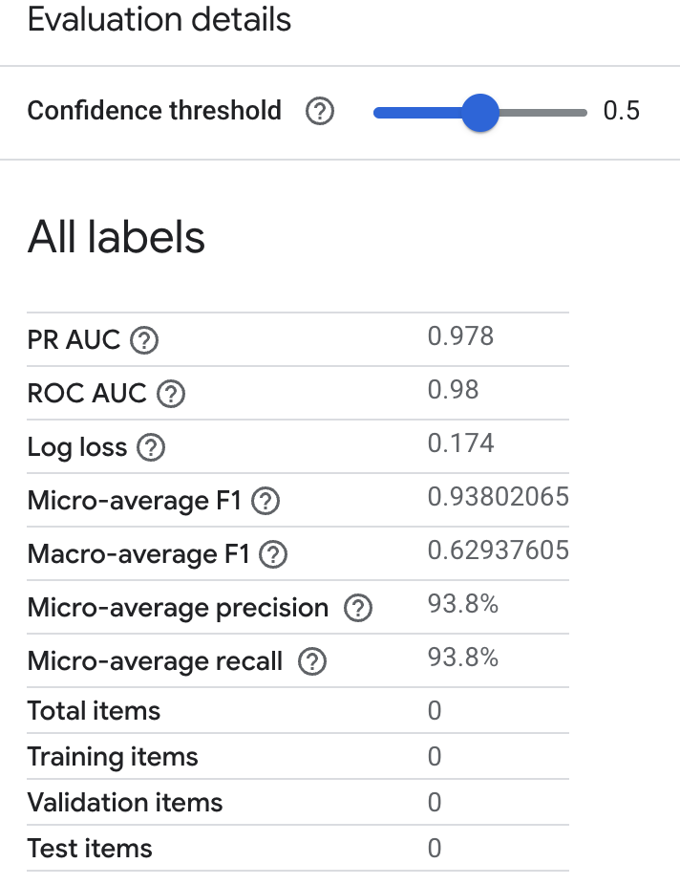
Credit Risk Classification Using AutoML Tables
Step 4: Review Results
PR AUC (Precision-Recall Area Under Curve):
measures how well the model balances precision vs. recall
Near 1.0 = excellent performance, especially on imbalance datasets
ROC AUC (Receiver Operating Characteristics):
Measures the model’s ability to separate the classes (default vs. non-default)
AUC = 1.0 is perfect
AUC = 0.5 means no better than random
Log Loss:
Penalizes confident wrong predictions
Lower is better

Slide 19
Credit Risk Classification Using AutoML Tables
Step 4: Review Results
Micro-average F1:
Average precision and recall across all instances
Good for imbalance datasets
Macro-average F1:
Average of F1 scores per class, without weighting
Penalizes models that ignore minority classes
Micro-average Precision:
93.8% of predicted defaults were actually defaults
Micro-average Recall:
93.8% of all actual defaults were corrected identified

Slide 20
Credit Risk Classification Using AutoML Tables
Step 4: Review Results
Summary:
This model is performing extremely well, with:
High precision & recall
Strong ROC and PR AUC
Excellent balance (Micro-F1)

Slide 21
Interpretability &
Risk

Slide 22
Overfitting: High accuracy on training, poor on test set
Explainability Tools: Use SHAP to understand feature impact
Compliance: Financial models must be explainable for audit and regulation

Slide 23
SHAP
SHAP, short for SHapley Additive exPlanations, is a method used to explain the output of any machine learning model
SHAP values provide insights into feature importance, local explanations, and model behavior, making it a valuable tool for interpreting and understanding machine learning models

Slide 24
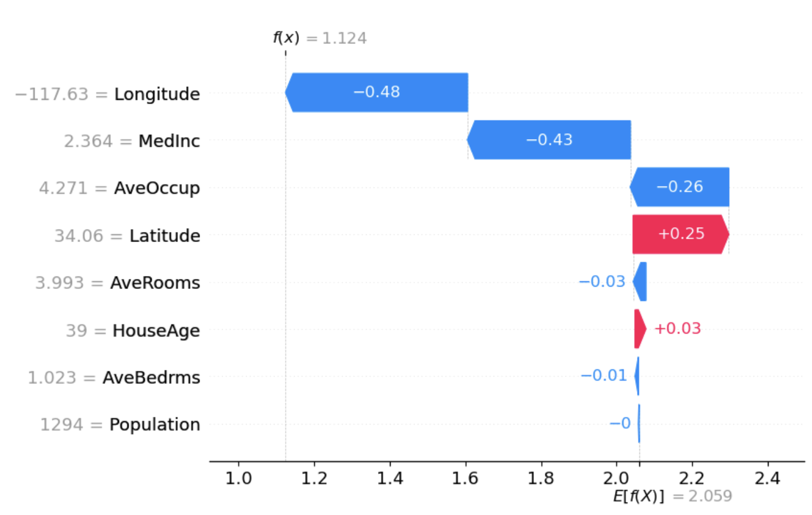
SHAP
The absolute SHAP value shows us how much a single feature affected the prediction, so Longitude contributed the most, MedInc the second one, AveOccup the third, and Population was the feature with the lowest contribution to the prediction.
https://towardsdatascience.com/using-shap-values-to-explain-how-your-machine-learning-model-works-732b3f40e137/

Slide 25
THANKS FOR WATCHING
2025

